Slide 1
8086 Instruction Set - 1
Data transfer instructions (including I/O transfers),
Binary arithmetic instructions,
Decimal (BCD, ASCII) arithmetic instructions,
Logical instructions,
Shift and rotate instructions,
Control transfer instructions.
1

Slide 2
Data Transfer Instructions

Slide 3
Data Transfer instructions essentially copy the data and do not affect any flags (except of course the POPF instruction which modifies all the flags as per the stack top word)

Slide 4
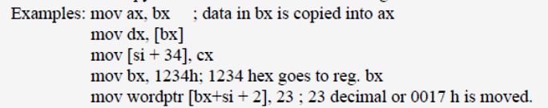
MOV
Stands for move, it is actually copy, that is, when data is moved from one register source to a destination register, source is not destroyed, only, there will be a copy of this data in the destination register

Slide 5

XCHG
Exchange instruction exchanges data between registers or between register and memory

Slide 6

PUSH
Push causes the data in the source register to be copied on to the stack top

Slide 7
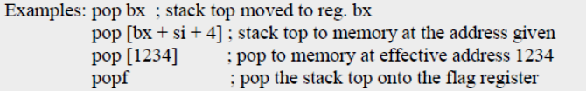
POP
Pop causes the stack top moved to (that is, removed from the stack and loaded onto) the destination register or memory specified by the instruction

Slide 8
IN: Copy data from a port
IN accumulator, port
The IN instruction reads from an input port into AL or AX (only these two registers), to be specified in the instruction
The port address is generally in the register DX
But if it is 8-bits or less, then it can also be directly given in the instruction

Slide 9
Ex:
IN AL,0C8H;Input a byte from port address 0C8H to AL
IN AX,34H; Input a word from port address 034H to AX
MOV DX,0FF78H ;Initialize DX to point to port
IN AL, DX ;Input a byte from 8 bit port 0FF78h to AL
IN AX,DX ; Input a word from 16 bit port 0FF78h to AX

Slide 10
OUT: output a byte or word to a port
OUT port, accumulator
The OUT instruction outputs the data in register AX or AL (only) to be specified in the instruction to the output port indicated directly in the instruction if the port address is 8 bits or less, or in the register DX (for addresses 16 bits or less)

Slide 11
Examples:
out 16h, ax; write to output port at address 16h from reg. ax
out dx, ax; write to output port at address in dx from reg. ax
out 23h, al; write to output port at address 23h from reg al
out dx, al; write to output port at address in dx from reg al

Slide 12
CBW (Convert byte to word)
The source register AL and the destination AX are both implied and not specifically mentioned in this instruction
This instruction is used to extend the 8-bit integer (signed number) in reg. AL to 16- bit integer in AX
The process is called sign extension

Slide 13
If the number in AL is positive, AH will be loaded with 00 hex, else AH will be loaded with FF hex
Example: cbw

Slide 14
CWD (Convert Word to Double Word)
Convert word in reg. AX (implied and not stated in the instruction) to double word in regs. DX:AX (also implied and not stated)
That is, sign extend from AX into DX:AX
Example: cwd

Slide 15
Among all the data transfer instructions popf is the only instruction that affects and modifies the flags

Slide 16
Binary Arithmetic Instructions

Slide 17
All binary arithmetic instructions update the flag register based on the result of the operation performed

Slide 18
ADD
Adds the first operand (destination operand) and the second operand (source operand) and stores the result in the destination operand
The destination operand can be a register or a memory location; the source operand can be an immediate, a register, or a memory location
Two memory operands cannot be used in one instruction

Slide 19
When an immediate value is used as an operand, it is sign-extended to the length of the destination operand format
The ADD instruction performs integer addition
DEST ← DEST + SRC;
The OF, SF, ZF, AF, PF, and CF flags are set according to the result
Examples: ADD AX, BX
ADD [BX + 4], DX
ADD CX, 2[SI]
ADD DX, 123 H

Slide 20
ADC
Adds with carry
Same as ADD with the following change in the operation:
DEST ← DEST + SRC + CF;
The OF, SF, ZF, AF, PF, and CF flags are set according to the result

Slide 21
Example…
data segment
a db 0ABh
b db 0A5h
c dw ?
data ends
code segment
assume cs:code, ds:data
start:
mov ax, data
mov ds, ax
mov al, a
add al, b
mov ah, 00h
adc ah, 00h
mov c, ax
mov ah, 4ch
int 21h
code ends
end start

Slide 22
SUB
Subtraction
Follows the same rules as ADD with the following change in the operation:
DEST ← DEST – SRC;
The OF, SF, ZF, AF, PF, and CF flags are set according to the result

Slide 23
SBB
Subtract with borrow
Same as SUB with the following change in the operation:
DEST ← DEST – (SRC + CF);
The OF, SF, ZF, AF, PF, and CF flags are set according to the result

Slide 24
CMP
Compare two operands
Compares the first source operand with the second source operand and sets the status flags in the FLAGS register according to the results
The comparison is performed by subtracting the second operand from the first operand and then setting the status flags in the same manner as the SUB instruction

Slide 25
When an immediate value is used as an operand, it is sign extended to the length of the first operand
Operation:
temp ← SRC1 − SRC2;
In case an immediate value is used, then
temp ← SRC1 − Sign Extend (SRC2);
The CF, OF, SF, ZF, AF, and PF flags are set according to the result

Slide 26
Examples:
CMP AX, 24 H; (24 is sign extended to 16 bits before subtraction, because AX is a 16-bit register)
CMP BYTEPTR[BX], -24 H; (no sign extension done, data in bytes are being handled)
CMP BX, SI
CMP AL, [BX]; (BX will be taken only as a byte pointer, as AL is a byte register)

Slide 27
MUL
Performs an unsigned multiplication of the first operand (destination operand) and the second operand (source operand) and stores the result in the destination operand
The destination operand is an implied operand located in register AL or AX (depending on the size of the operand)

Slide 28
The source operand is located in a general-purpose register or a memory location
Operation:
  IF byte operation
  THEN
  AX ← AL ∗ SRC
  ELSE (* word operation *)
  DX:AX ← AX ∗ SRC

Slide 29
  Flags Affected
  The OF and CF flags are set to 0 if the upper half of
  the result is 0; otherwise, they are set to 1
  The SF, ZF, AF, and PF flags are undefined
  Examples:
  MUL BX
  MUL WORDPTR [BX + DI]48 H
  MUL BYTEPTR [SI]
  MUL CL

Slide 30
IMUL : multiply signed numbers
IMUL source
Integer (signed) multiply
Similar to MUL, except the data are considered as signed integers
Flags are also affected similarly as for MUL

Slide 31
Examples:
IMUL BH ;Signed byte in AL times signed byte in BH ; result in AX
;69x14
;AL=01000101=45h=69 decimal
;BH=0000 1110=0Eh=14 decimal
IMUL BH;AX=03C6H=+966 decimal
; MSB=0,positive result magnitude in true form.
;-28x59
;AL=11100100=E4H=-1CH=-28 decimal
;BH=00111011=3BH=+59 decimal
IMUL BH;AX=F98CH=-1652 decimal
;MSB=1,negative result magnitude in 2’s complement form.

Slide 32
DIV:
Divide the unsigned integer dividend in the accumulator by the unsigned integer divisor specified in the instruction
If the divisor specified is a word register or word memory, the dividend is considered to be the double word in DX:AX and the quotient of division will be in register AX, with the remainder in register DX and the divisor word specified in the instruction will not be altered

Slide 33
If the divisor specified in the instruction is a byte register or byte memory, then the accumulator will be the word register AX
The quotient of the division will be in AL register, and AH register will have the remainder
In case of word division, if the divisor word is not greater than the part of the dividend word in DX, then the quotient obviously will not fit into the register AX

Slide 34
Execution of DIV instruction in such a case will cause a division overflow exception to be generated, and operating system should take care of this exception

Slide 35
Examples of DIV instruction:
DIV BX;
DIV WORDPTR [DI];
DIV CL;
DIV BYTEPTR [SI];

Slide 36
IDIV : devide by signed byte or word
IDIV source
Integer divide, same as DIV but the data and the results are considered as signed integers
The CF, OF, SF, ZF, AF, and PF flags are undefined, when IDIV is executed

Slide 37
Examples:
IDIV BH ;Signed word in AX/ signed byte in BH;
;AX=00000011 10101011=03ABH=939 decimal
;BH=1101 0011=D3=-2DH=-45 decimal
IDIV BH ;Quotient: AL=ECH=-14H=-20 decimal
;remainder: AH=27H=+39 decimal

Slide 38
INC
Increment register or memory
This involves only a single operand
Adds 1 to the destination operand, while preserving the state of the CF flag
The destination operand can be a register or a memory location

Slide 39
This instruction allows a loop counter to be updated without disturbing the CF flag
If we use an ADD instruction with an immediate operand of 1 to perform an increment operation that does update the CF flag
Operation:
DEST ← DEST + 1;
The CF flag is not affected. The OF, SF, ZF, AF, and PF flags are set according to the result

Slide 40
DEC
Similar to INC, this instruction does the operation:
DEST ← DEST – 1;
The CF flag is not affected
The OF, SF, ZF, AF, and PF flags are set according to the result

Slide 41
NEG: Form 2’s complement
NEG destination
Replaces the value of operand (the destination operand) with its two’s complement
This operation is equivalent to subtracting the operand from 0
The destination operand is located in a general-purpose register or a memory location
DEST ← – (DEST)

Slide 42
Flags Affected
The CF flag set to 0 if the source operand is 0; otherwise it is set to 1
The OF, SF, ZF, AF, and PF flags are set according to the result
Ex: ;AL=0000 0110H=06H
NEG AL ; replace number in AL with its 2’s complement
;RESULT:1111 1010=FAH

Slide 43
Decimal (BCD, ASCII) Arithmetic Instructions

Slide 44
DAA: Decimal adjust accumulator (AL) after BCD addition
Adjusts the sum of two packed BCD values to create a packed BCD result
The AL register is the implied source and destination operand
The DAA instruction is only useful when it follows an ADD instruction that adds (binary addition) two 2 - digit, packed BCD values and stores a byte result in the AL register

Slide 45
The DAA instruction then adjusts the contents of the AL register to contain the correct 2-digit, packed BCD result
If a decimal carry is detected, the CF and AF flags are set accordingly
If the lower nibble in AL after an addition is greater than 9 or AF was set by the addition, then the DAA instruction will add 6 to the lower nibble in AL

Slide 46
If the result in the upper nibble of AL is now greater then 9 or if the carry flag was set by the addition or correction, then DAA instruction will add 60H to AL

Slide 47
Example 1:
; AL = 0101 1001 = 59 BCD
; BL = 0011 0101 = 35 BCD
ADD AL, BL ; AL = 1000 1110 = 8EH
DAA ; Add 0110 Because 1110 > 9
; AL = 1001 0100 = 94 BCD

Slide 48
Example 2:
; AL = 1000 1000 = 88 BCD
; BL = 0100 1001 = 49 BCD
ADD AL, BL ; AL = 1101 0001=D1h, AF = 1
DAA ; Add 0110 because AF=1
; AL = 1101 0111 = D7H
; 1101 > 9 so add 0110 0000
; AL = 0011 0111 = 37 BCD, CF = 1

Slide 49
Flags affected
The CF and AF flags are set if the adjustment of the value results in a decimal carry in either digit of the result
The SF, ZF, and PF flags are set according to the result
The OF flag is undefined

Slide 50
DAS: Decimal adjust after BCD subtraction
Adjusts the result of the subtraction of two packed BCD values to create a packed BCD result
The AL register is the implied source and destination operand
The DAS instruction is only useful when it follows a SUB instruction that subtracts (binary subtraction) one 2-digit, packed BCD value from another and stores a byte result in the AL register

Slide 51
The DAS instruction then adjusts the contents of the AL register to contain the correct 2-digit, packed BCD result
If a decimal borrow is detected, the CF and AF flags are set accordingly
The CF and AF flags are set if the adjustment of the value results in a decimal borrow in either digit of the result
The SF, ZF, and PF flags are set according to the result. The OF flag is undefined

Slide 52
Examples:
;AL=1000 0110=86BCD
; BH=0101 0111=57BCD
SUB AL,BH ;AL=0010 1111=2FH,CF=0
DAS ;Lower nibble of result is 1111,so DAS automatically subtracts 0000 0110 to give AL=0010 1001=29BCD
;AL=0100 1001=49BCD
;BH=0111 0010=72BCD
SUB AL,BH ;AL=1101 0111=D7H,CF=1
DAS ;Subtracts 0110 0000(-60H) bcoz 1101 in upper nibble >9
;AL=01110111=77BCD,CF=1
;CF=1 means borrow was needed

Slide 53
AAA: ASCII adjust AL after addition
Adjusts the sum of two unpacked BCD values to create an unpacked BCD result
The AAA instruction works only on the AL register .It is the implied source and destination operand for this instruction
The AAA instruction is only useful when it follows an ADD instruction that adds (binary addition) two unpacked BCD values and stores a byte result in the AL register

Slide 54
Example:
;assume AL=0011 0101,ASCII5 BL=0011 1001,ASCII 9
ADD AL,BL; Result: AL=01101110=6EH,Which is incorrect BCD
AAA; Now AL=0000 0100,Unpacked BCD 4.
;CF=1 indicates answer is 14 decimal

Slide 55
The AAA instruction then adjusts the contents of the AL register to contain the correct 1-digit unpacked BCD result
If the addition produces a decimal carry, the AH register increments by 1, and the CF and AF flags are set
If there was no decimal carry, the CF and AF flags are cleared and the AH register is unchanged
In either case, bits 4 through 7 of the AL register are set to 0

Slide 56
The AF and CF flags are set to 1 if the adjustment results in a decimal carry otherwise they are set to 0
The OF, SF, ZF, and PF flags are undefined

Slide 57
IF ((AL AND 0FH) > 9) OR (AF = 1)
THEN
AL ← AL + 6;
AH ← AH + 1;
AF ← 1;
CF ← 1;
ELSE
AF ← 0;
CF ← 0;
AL ← AL AND 0FH;

Slide 58
AAS: ASCII adjust AL after subtraction
Adjusts the result of the subtraction of two unpacked BCD values to create a unpacked BCD result
The AL register is the implied source and destination operand for this instruction
The AAS instruction is only useful when it follows a SUB instruction that subtracts (binary subtraction) one unpacked BCD value from another and stores a byte result in the AL

Slide 59
The AAA instruction then adjusts the contents of the AL register to contain the correct 1-digit unpacked BCD result
If the subtraction produced a decimal carry, the AH register decrements by 1, and the CF and AF flags are set. If no decimal carry occurred, the CF and AF flags are cleared, and the AH register is unchanged
In either case, the AL register is left with its top nibble set to 0

Slide 60
Example:
;assume BL=0011 1001=39h=ASCII 9
AL=0011 0101=35h=ASCII5
ASCII9-ASCII5
SUB AL,BL ; Result: AL=0000 0100=BCD 04 and CF=0
AAS ; result:AL=0000 0100= BCD 04 and CF=0;no borrow required
;assume AL=0011 0101=35h=ASCII5
BL=0011 1001=39h=ASCII 9
;ASCII 5-ASCII9
SUB AL,BL; Result: AL=1111 1100=-4 in 2’s compliment and CF=1
AAS; result: AL=0000 0100= BCD 04 and CF=1; borrow needed

Slide 61
IF ((AL AND 0FH) > 9) OR (AF = 1)
THEN
AL ← AL – 6;
AH ← AH – 1;
AF ← 1;
CF ← 1;
ELSE
CF ← 0;
AF ← 0;
AL ← AL AND 0FH;

Slide 62
AAM: ASCII adjust AX after multiply
Adjusts the result of the multiplication of two unpacked BCD values to create a pair of unpacked (base 10) BCD values
AAM works only after the multiplication of two unpacked BCD bytes and it works only on an operand in AL.
After the 2 unpacked BCD digits(one BCD digit per byte) are multiplied, the AAM instruction is used to adjust the product to two unpacked BCD digits in AX

Slide 63
The AAM instruction then adjusts the contents of the AX register to contain the correct 2-digit unpacked (base 10) BCD result
Example:
;AL=0000 0101=unpacked BCD 5
; BH=0000 1001=unpacked BCD 9
MUL BH ;AL x BH; result in AX
;AX=00000000 00101101=002DH
AAM ;AX=00000100 00000101=0405H
;which is unpacked BCD for 45

Slide 64
AAD: ASCII adjust AX before division
AAD converts two unpacked BCD digits in AH and AL to the equivalent binary number in AL
Adjusts two unpacked BCD digits (the least significant digit in the AL register and the most significant digit in the AH register) so that a division operation performed on the result will yield a correct unpacked BCD value
The AAD instruction is only useful when it precedes a DIV instruction that divides (binary division) the adjusted value in the AX register by an unpacked BCD value

Slide 65
The AAD instruction sets the value in the AL register to (AL + (10 * AH)), and then clears the AH register to 00H
The value in the AX register is then equal to the binary equivalent of the original unpacked two digit (base 10) number in registers AH and AL

Slide 66
Example:
;AX =0607H unpacked BCD for 67 decimal
;CH=09H
AAD; result: AX=0043=43H=67 decimal
DIV CH; devide AX by unpacked BCD in CH
;quotient:AL=07 unpacked BCD
;remainder : AH=04 unpacked BCD
;flags undefined after DIV

Slide 67
Logical Instructions

Slide 68
AND
Performs a bitwise AND operation on the destination (first) and source (second) operands and stores the result in the destination operand location
The source operand can be an immediate, a register, or a memory location; the destination operand can be a register or a memory location

Slide 69
Each bit of the result is set to 1 if both corresponding bits of the first and second operands are 1; otherwise, it is set to 0
Operation:
DEST ← DEST AND SRC;
Flags Affected:
The OF and CF flags are cleared; the SF, ZF, and PF flags are set according to the result; The state of the AF flag is undefined

Slide 70
OR
Performs a bitwise inclusive OR operation between the destination (first) and source (second) operands and stores the result in the destination operand location
The source operand can be an immediate, a register, or a memory location; the destination operand can be a register or a memory location

Slide 71
Each bit of the result of the OR instruction is set to 0 if both corresponding bits of the first and second are 0; otherwise it is set to 1
Operation:
DEST ← DEST OR SRC;
Flags Affected:
The OF and CF flags are cleared; the SF, ZF, and PF flags are set according to the result; The state of the AF flag is undefined

Slide 72
XOR
Performs a bitwise exclusive OR (XOR) operation on the destination (first) and source (second) operands and stores the result in the destination operand location
The source operand can be an immediate, a register, or a memory location; the destination operand can be a register or a memory location

Slide 73
Each bit of the result is 1 if the corresponding bits of the operands are different; each bit is 0 if the corresponding bits are the same
Operation:
DEST ← DEST XOR SRC;
Flags Affected:
The OF and CF flags are cleared; the SF, ZF, and PF flags are set according to the result; The state of the AF flag is undefined

Slide 74
NOT
Performs a bitwise NOT operation (each 1 is set to 0, and each 0 is set to 1) or does 1’s complementing on the destination operand and stores the result in the destination operand location
The destination operand can be a register or a memory location

Slide 75
Operation:
DEST ← NOT DEST;
Flags Affected:
None

Slide 76
TEST
Bitwise AND the two sources operands, ignore the outcome, but preserve the nature of the result in the flag register
This instruction computes the bit-wise logical AND of first operand (source 1 operand) and the second operand (source 2 operand) and sets the SF, ZF, and PF status flags according to the result
The result is then discarded

Slide 77
Operation:
TEMP ← SRC1 AND SRC2;
SF ← MSB(TEMP);
IF TEMP = 0
THEN ZF ← 1;
ELSE ZF ← 0;
PF ← Parity of the lower 8-bits of TEMP;
CF ← 0;
OF ← 0;
(*AF is Undefined*)

Slide 78
Shift and Rotate
Instructions

Slide 79
Shift and rotate instructions shift the data by one or more bits towards either left or right, straight or in a circular fashion
The carry flag is always involved in these operations

Slide 80
Shift Instructions…
Shift instructions position or move numbers to the left or right within a register or memory location
Two are logical shifts and two are arithmetic shifts

Slide 81
The logical shifts move a 0 into the rightmost bit position for a logical left shift and a 0 into the leftmost bit position for a logical right shift
The arithmetic and logical left shifts are identical

Slide 82
The arithmetic and logical right shifts are different because the arithmetic right shift copies the sign-bit through the number, while the logical right shift copies a 0 through the number
Logical shift operations function with unsigned numbers, and arithmetic shifts function with signed numbers

Slide 83
Logical shifts multiply or divide unsigned data, and arithmetic shifts multiply or divide signed data
A shift left always multiplies by 2 for each bit position shifted, and a shift right always divides by 2 for each bit position shifted

Slide 84
The logical shift instructions are SHL, SHR
The arithmetic shift instructions are SAL, SAR

Slide 85
SHL – Shift Operand Bits Left, Put Zero in LSBs
SHL Destination, Count

Slide 86
As a bit is shifted out of the LSB position, a zero is put in the LSB position
The MSB will be shifted to CF
CF ← MSB LSB ← 0

Slide 87
If the desired number of shifts is 1, this can be specified by putting a 1 in the count position of the instruction
For shifts of more than 1 bit position, the desired number of shifts is loaded into the CL register
Example:
MOV CL, 05H
SHL AX, CL

Slide 88
SAL – Shift Operand Bits Left, Put Zero in LSBs
SAL Destination, Count

Slide 89
As a bit is shifted out of the LSB position, a zero is put in the LSB position
The MSB will be shifted to CF
CF ← MSB LSB ← 0

Slide 90
If the desired number of shifts is 1, this can be specified by putting a 1 in the count position of the instruction
For shifts of more than 1 bit position, the desired number of shifts is loaded into the CL register
Example:
MOV CL, 05H
SAL AX, CL

Slide 91
SHR – Shift Operand Bits Right, New MSB = 0
SHR Destination, Count

Slide 92
This instruction shifts each bit in the specified destination some number of bit positions to the right
As a bit is shifted out of the MSB position, 0 is put in the MSB position
The LSB will be shifted into CF

Slide 93
0 → MSB LSB → CF

Slide 94
If the desired number of shifts is 1, this can be specified by putting a 1 in the count position of the instruction
For shifts of more than 1 bit position, the desired number of shifts is loaded into the CL register
Example:
MOV CL, 03H
SHR AL, CL

Slide 95
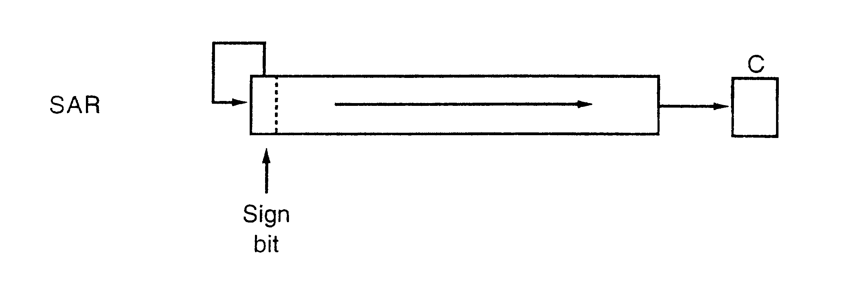
SAR

Slide 96
This Arithmetic shift right instruction copies the sign bit through the number
SAR Destination, Count

Slide 97
If the desired number of shifts is 1, this can be specified by putting a 1 in the count position of the instruction
For shifts of more than 1 bit position, the desired number of shifts is loaded into the CL register
Example:
MOV CL, 03H
SAR AL, CL

Slide 98
ROL – Rotate All Bits of Operand Left, MSB to LSB
ROL Destination, Count
This instruction rotates all the bits in a specified word or byte to the left some number of bit positions
CF← MSB LSB

Slide 99
If the desired number of shifts is 1, this can be specified by putting a 1 in the count position of the instruction
For shifts of more than 1 bit position, the desired number of shifts is loaded into the CL register
Example:
MOV CL, 03H
ROL AL, CL

Slide 100
ROR – Rotate All Bits of Operand Right, LSB to MSB
ROR Destination, Count
This instruction rotates all the bits in a specified word or byte to the right some number of bit positions
CF MSB LSB

Slide 101
If the desired number of shifts is 1, this can be specified by putting a 1 in the count position of the instruction
For shifts of more than 1 bit position, the desired number of shifts is loaded into the CL register
Example:
MOV CL, 03H
ROR AL, CL

Slide 102
For the ROL and ROR instructions, the original value of the CF flag is not a part of the result, but the CF flag receives a copy of the bit that was shifted from one end to the other

Slide 103
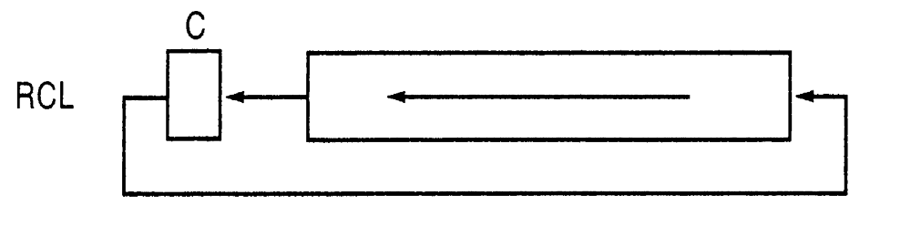
RCL (Rotate Left including carry)
The RCL instruction shifts the CF flag into the least-significant bit and shifts the most significant bit into the CF flag

Slide 104
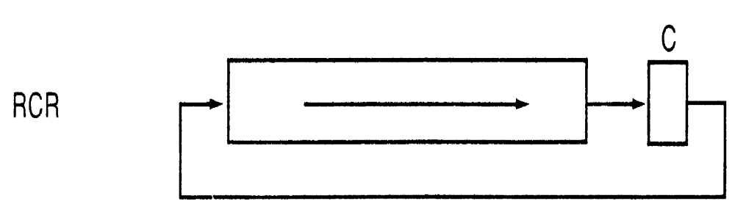
RCR (Rotate Right including carry)
The RCR instruction shifts the CF flag into the most-significant bit and shifts the least- significant bit into the CF flag

Slide 105
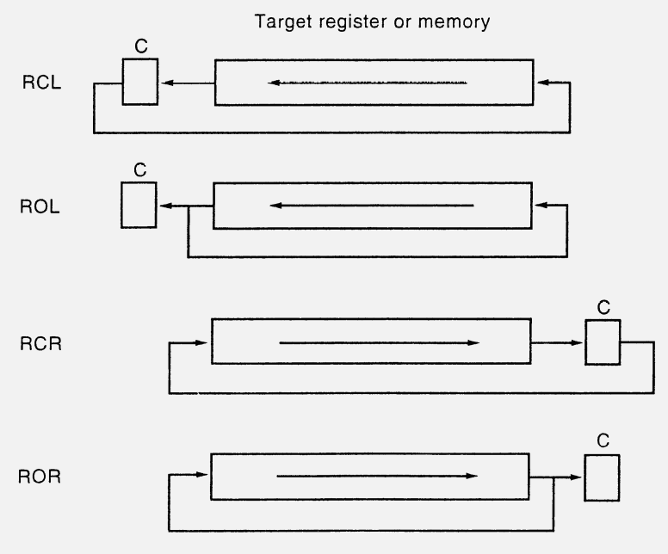

Slide 106
Control Transfer
Instructions

Slide 107
The intelligence in any program lies in the ability of the program to follow different courses of action based on intermediate results produced during the working of the program; that way, the program is enabled to perform data sensitive tasks
This capability is obtained by context sensitive jump operations, in contrast to the normal sequential cyclical operation of fetching the next instruction and executing it, in the order in which it is found in the program

Slide 108
JMP: Jump instruction
Transfers program control to a different point in the instruction stream without recording return information
This instruction can be used to execute three different types of jumps: Near Jump, Short Jump and Far Jump…

Slide 109
Near jump—A jump to an instruction within the current code segment (the segment currently pointed to by the CS register), sometimes referred to as an intra segment jump
Short jump—A near jump where the jump range is limited to –128 to +127 from the current IP value
Far jump—A jump to an instruction located in a different segment than the current code segment, is sometimes referred to as an inter segment jump
The CS register is not changed on near and short jumps…

Slide 110
Conditional Jump Instructions…

Slide 111
MNEMONIC | CONDITION TESTED
JA/JNBE(jump if above/jump if not below or equal) | (CF AND ZF) =0
JAE/JNB/JNC(jump if above or equal/jump if not below /jump if no carry) | CF=0
JB/JNAE/JC(jump if below/jump if not above or equal/jump if carry) | CF=1
JBE/JNA(jump if below or equal/jump if not above) | (CF OR ZF)=1
JCXZ(jump if CX register is zero) | CX = 0
JE/JZ(jump if equal/jump if zero) | ZF = 1
JG/JNLE(jump if greater/jump if not less than of equal) | ((SF XOR OF) OR ZF ) =0

Slide 112
MNEMONIC | CONDITION TESTED
JGE/JNL(jump if greater than or equal/jump if not less than) | (SF XOR OF)=0
JL/JNGE(jump if less than/jump if not greater than or equal) | (SF XOR OF)=1
JLE/JNG(jump if less than or equal/jump if not greater) | ((SF XOR OF) OR ZF )=1
JNE/JNZ(jump if not equal/jump if not zero) | ZF=0
JNO(jump if no overflow) | OF=0 (not overflow)
JNP/JPO(jump if no parity/jump if parity odd) | PF=0 (not parity/parity odd)
JNS(jump if not signed, jump if positive) | SF=0 (not sign)

Slide 113
MNEMONIC | CONDITION TESTED
JO(jump if overflow) | OF=1 (overflow)
JP/JPE(jump if parity/jump if parity even) | PF (Parity / parity equal)
JS(jump if signed) | SF=1 (Sign)

Slide 114
LOOP Instruction
The LOOP instructions are basically conditional jump instructions which have the format
  LOOP LABEL

Slide 115
LOOP instruction combines 2 operations in each instruction
The first operation is to decrement the CX register by 1
The second operation is to check the CX register and, in some cases, also the zero flag to decide whether to do a jump to the specified label

Slide 116
LOOP(jump to specified label if cx≠0 after auto decrement) | Loop Until CX=0
LOOPE / LOOPZ(loop while cx≠0 and zf=1) | Loop if zero flag is set and CX !=0
LOOPNE / LOOPNZ(loop while cx≠0 and zf=0) | Loop if zero flag not set and CX !=0

Slide 117
CALL
Call instruction is a returnable jump to the destination or the target address provided in the instruction
This instruction can be used to execute two different types of calls:
Near call — A call to a procedure within the current code segment (the segment currently pointed to by the CS register), sometimes referred to as an intra segment call
Far call — A call to a procedure located in a different segment than the current code segment, sometimes referred to as an inter segment call

Slide 118
When executing a near call, the processor pushes the value of the IP register (which contains the offset of the instruction following the CALL instruction) onto the stack (for use later as a return-instruction pointer)
The processor then branches to the address in the current code segment specified with the target operand
The CS register is not changed on near calls

Slide 119
When executing a far call, the processor pushes the current value of both the CS and IP registers onto the stack for use as a return-instruction pointer
The processor then performs a “far branch” to the code segment and offset specified with the target operand for the called procedure

Slide 120
RET
The RET (return) instruction returns control back from the procedure to the program that has called the procedure
The control will be returned to the instruction following the procedure call
This instruction transfers program control to a return address located on the top of the stack

Slide 121
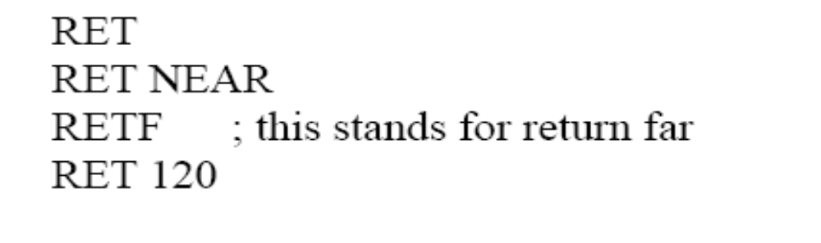
The address is usually placed on the stack by a CALL instruction, and the return is made to the instruction that follows the CALL instruction
The optional source operand specifies the number of stack bytes to be released after the return address is popped; the default is none

Slide 122
INT –interrupt program execution
INT type
These instructions are software interrupt procedure calls
The term type in the instruction format refers to a number between 0 to 255 which identifies interrupt

Slide 123
When an 8086 executes an INT instruction it will
Decrements the stack pointer by 2 and push the flags onto the stack
Decrements the stack pointer by 2 and push the contents of CS onto stack
Decrement the stack pointer by 2 and push the offset of the next instruction(IP) after the INT instruction on the stack

Slide 124
Get a new value of IP from an absolute memory address of 4 times the type specified in the instruction
Ex: for INT 8 instruction, a new IP will be read from address 00020H.
Get a new value for CS from an absolute memory address of 4 times the type specified in the instruction plus 2
Ex: for an INT 8 instruction the new value of CS will be read from address 00022H
Reset both IF and TF .other flags are not affected

Slide 125
IRET: Return from interrupt
The IRET instruction performs a far return to the interrupted program or procedure
During this operation, the processor pops the return instruction pointer, return code segment selector, and FLAGS image from the stack to the IP, CS, and FLAGS registers, respectively, and then resumes execution of the interrupted program or procedure

